Slide 1
Bradley Woods Residential 2025
17th May – 18th May 2025

Slide 2
Timings
Arrival at Bradley Woods (Shepards Thorn Lane, Brighouse, HD6 3TU)
Between : 10:30am - 11am on Saturday 17th May 2025
Collection at Bradley Woods
Around 2pm
You must inform us in advance who is collecting your child. Whether that be another relative or a parent of another child within class. We will not under any circumstance allow your child to go with another adult if we haven’t been informed accordingly.
If case of any last minute changes please contact the school admin address and this information will be relayed to staff.

Slide 3
Itinerary
Day 1
AM – Arrival, settle in and lunch
1300-1400 – Activity 1
1415-1515 – Activity 2
1515-1615- Activity 3
1615 onwards – free time / tea
Day 2
0830-0915 Breakfast
0930 – 1030 – Activity 4
1045-1145 – Activity 5
1200-1300 – Lunch
14:00 – Departure

Slide 4
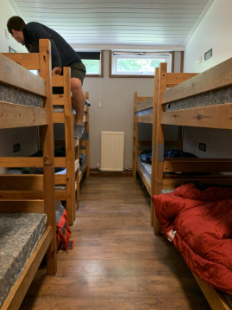
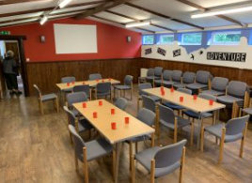
Accommodation

Slide 5
Staff from school
The activities will be run by qualified members of staff from the centre, first aid trained and DBS checked. Members of school staff will also be accompanying the children:-
Mr Barker
Miss Barnes

Slide 6
SUGGESTED KIT LIST - BRADLEY WOODS ACTIVITY CENTRE
Sleeping bag / sheet and duvet
Pillow
Walking boots or trainers
Waterproof coat
Towels x 2 (small and large)
Toothpaste and brush
Toiletries eg, shampoo, shower gel, deodorant – no sprays
Brush/comb
Lip cream – for chapped lips
Sun-cream
Midge repellent – can be useful during May
Nightwear
Underwear
Socks
Shirts/blouses/tee-shirts
Jumpers/sweatshirts – warm ones
Track pants / trousers – for through the day
Jeans – evening only
Shorts – nylon ones are best
Thick warm socks – to be worn with boots. Wool / nylon loop stitch are idea. ‘Trainer’ socks to be avoided.
Indoor shoes / trainers
Headwear – woollen / fleece hat for warmth, plus a sun hat that offers protection to ears and back of the neck.
Gloves – woollen or synthetic ‘ski-type’ are best
Jacket/Hoodie
Bin liner for wet, dirty clothes to take home
Name tags – all clothes to be named
Small games/comic etc
Medicines – if required

Slide 7
Activities
Bradley Woods Activity Centre have organised and tailored a fantastic weekend for us, we will be having the opportunity to take part in the following activities:
Cave Bus
Challenge Valley
Team Building
Climbing
Vertical Challenge

Slide 8
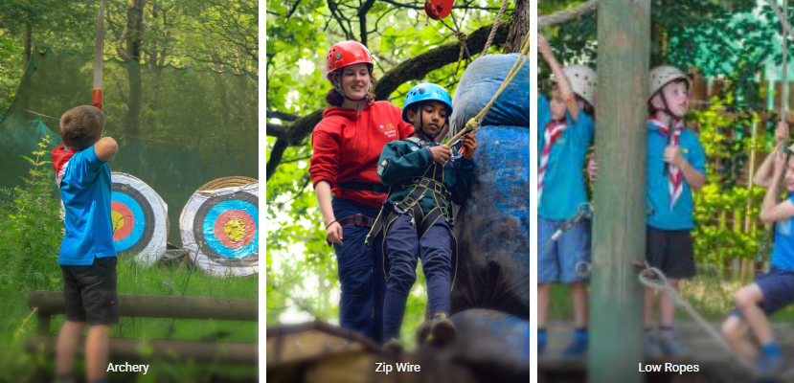
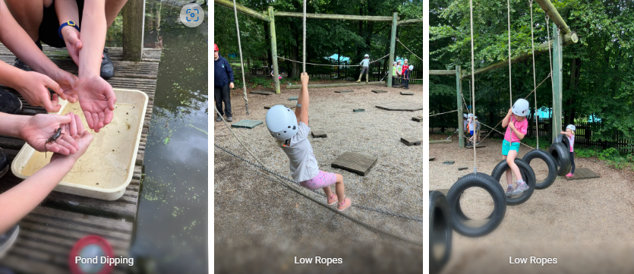

Slide 9
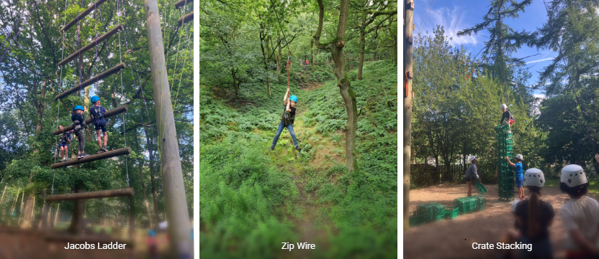
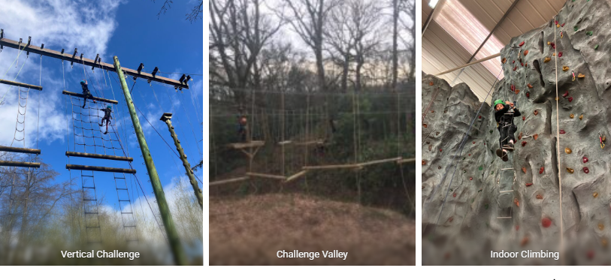

Slide 10
Medical and forms
Please complete the medical form we give you fully by 12th May 2025.
Please give all your medicine to a member of staff when you arrive at Bradley Woods on Saturday Morning. If any medication arrives on Saturday morning without the correct documentation we will not administer.
If there are any changes in your child's medication before we go, we will have spare medical forms but please be aware we will expect a form filled out.

Slide 11
EXTRA information
Dorms
Behaviour
Food
Items from kit list to talk about
Parent contact
Medical
Questions / concerns

